Slide 1
Dimensionality on 2-D Graph
John F. Tripp

Slide 2
Hans Rosling
What is the Maximum number of data dimensions (fields) that can be displayed on an X-Y “Scatterplot” type graph?

Slide 3
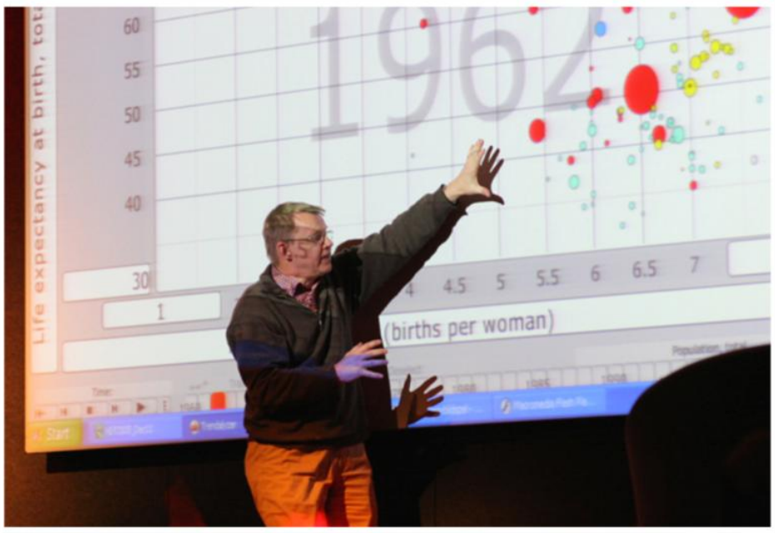
Example – Hans Rosling

Slide 4
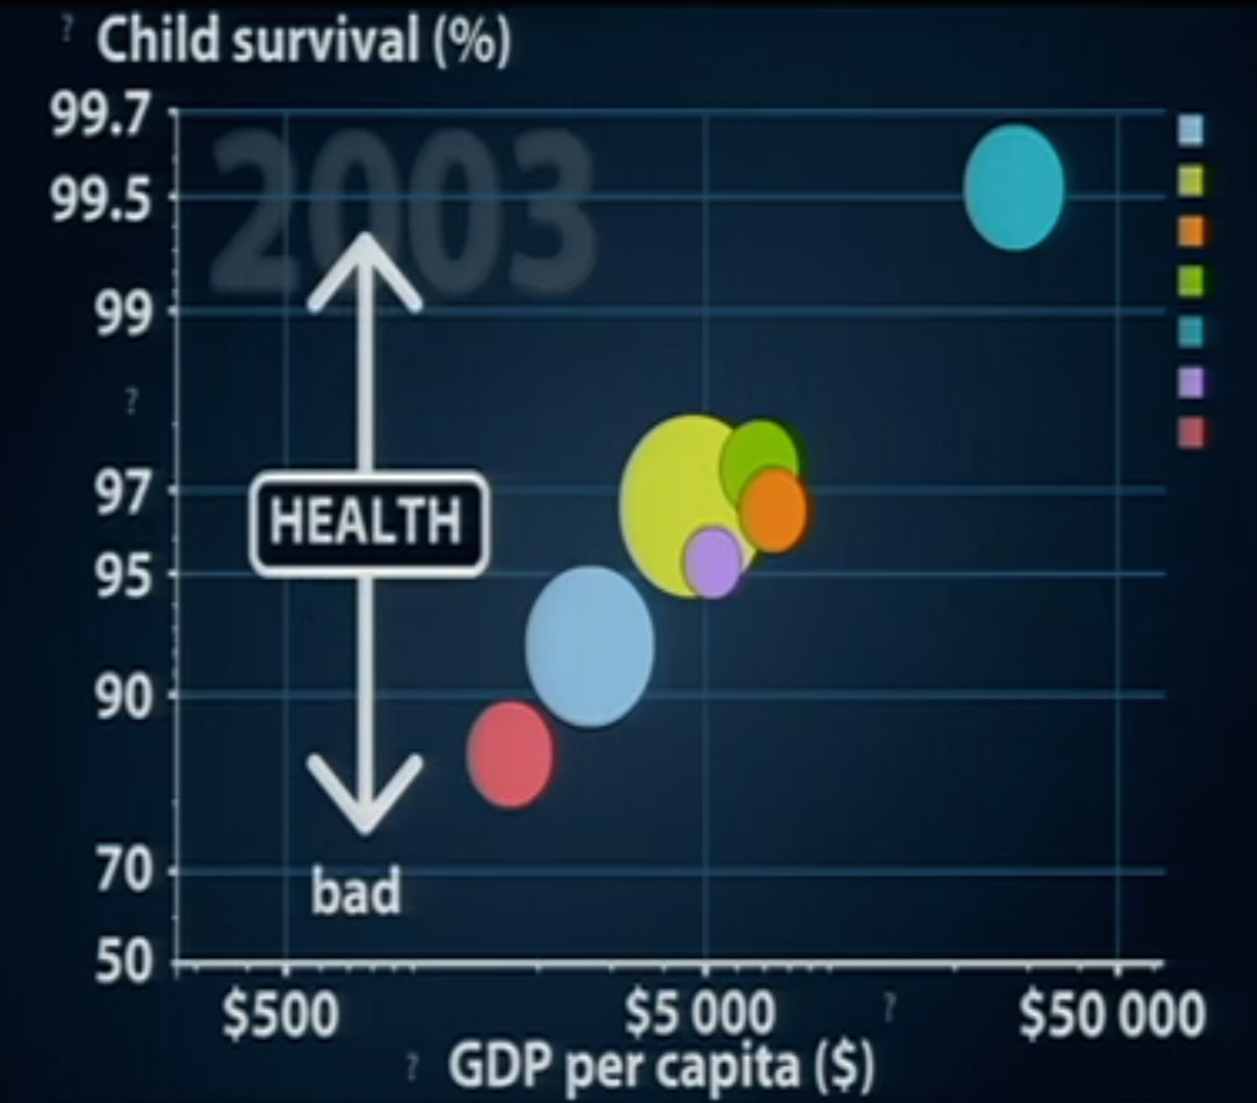

Slide 5
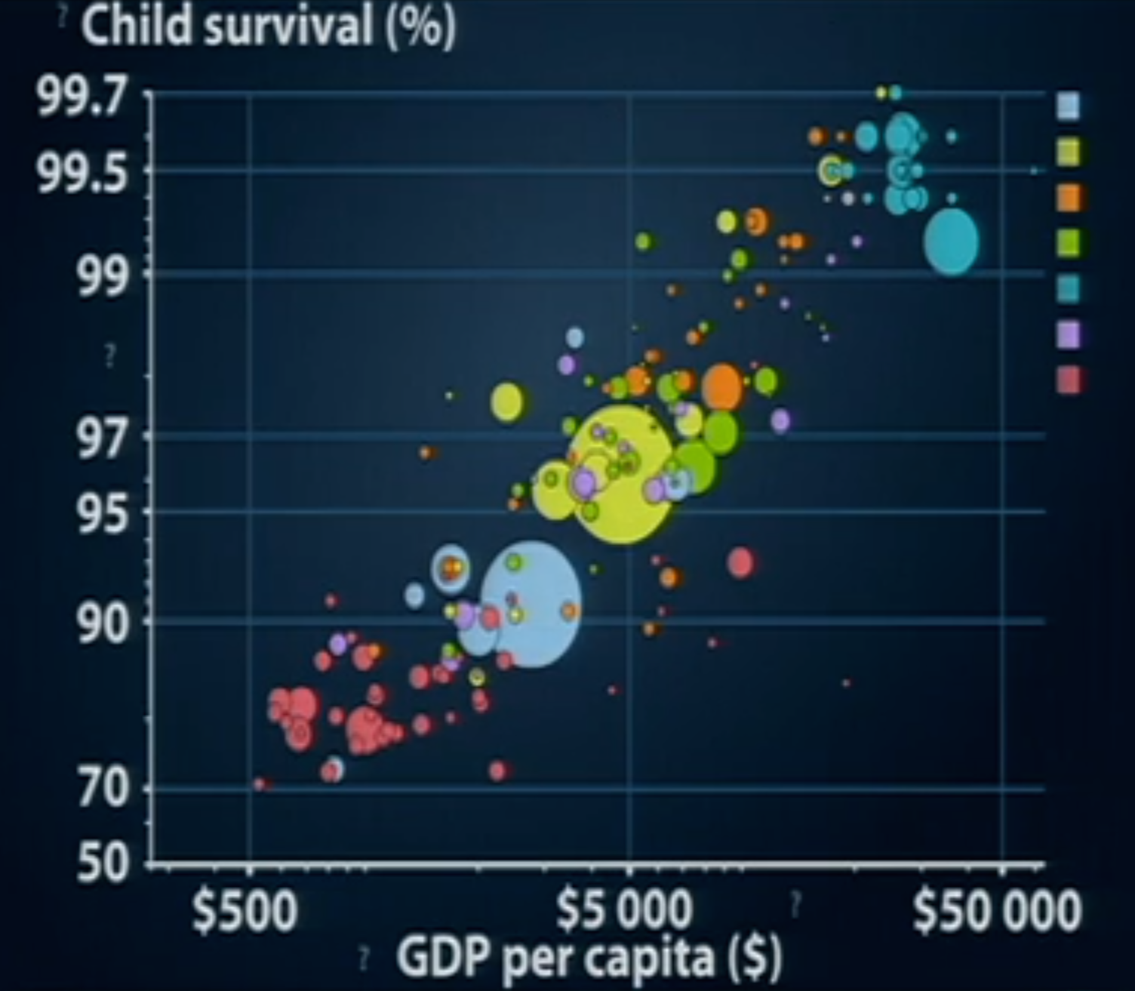

Slide 6
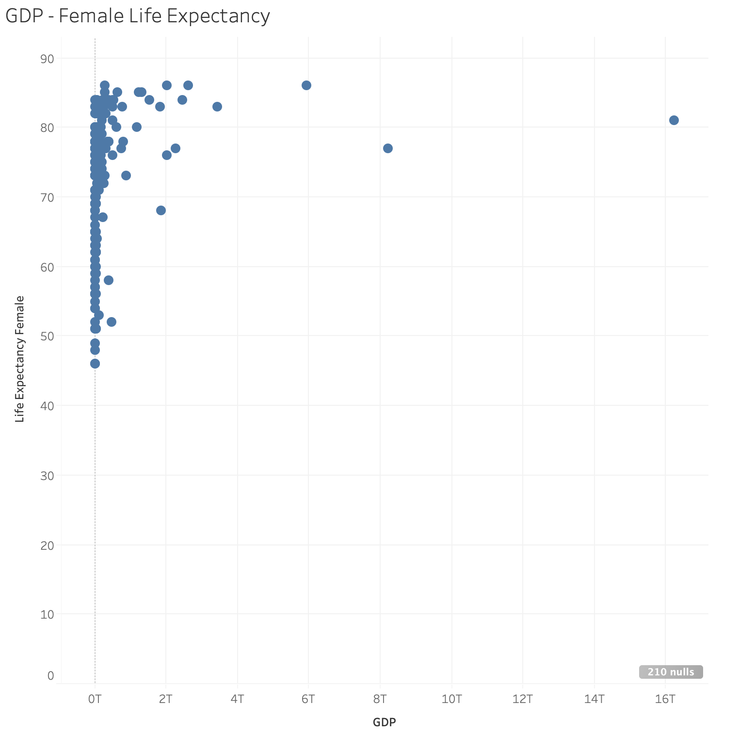
Maximum # of Data Dimensions on 2-D Graph
X-Position
Y-Position

Slide 7
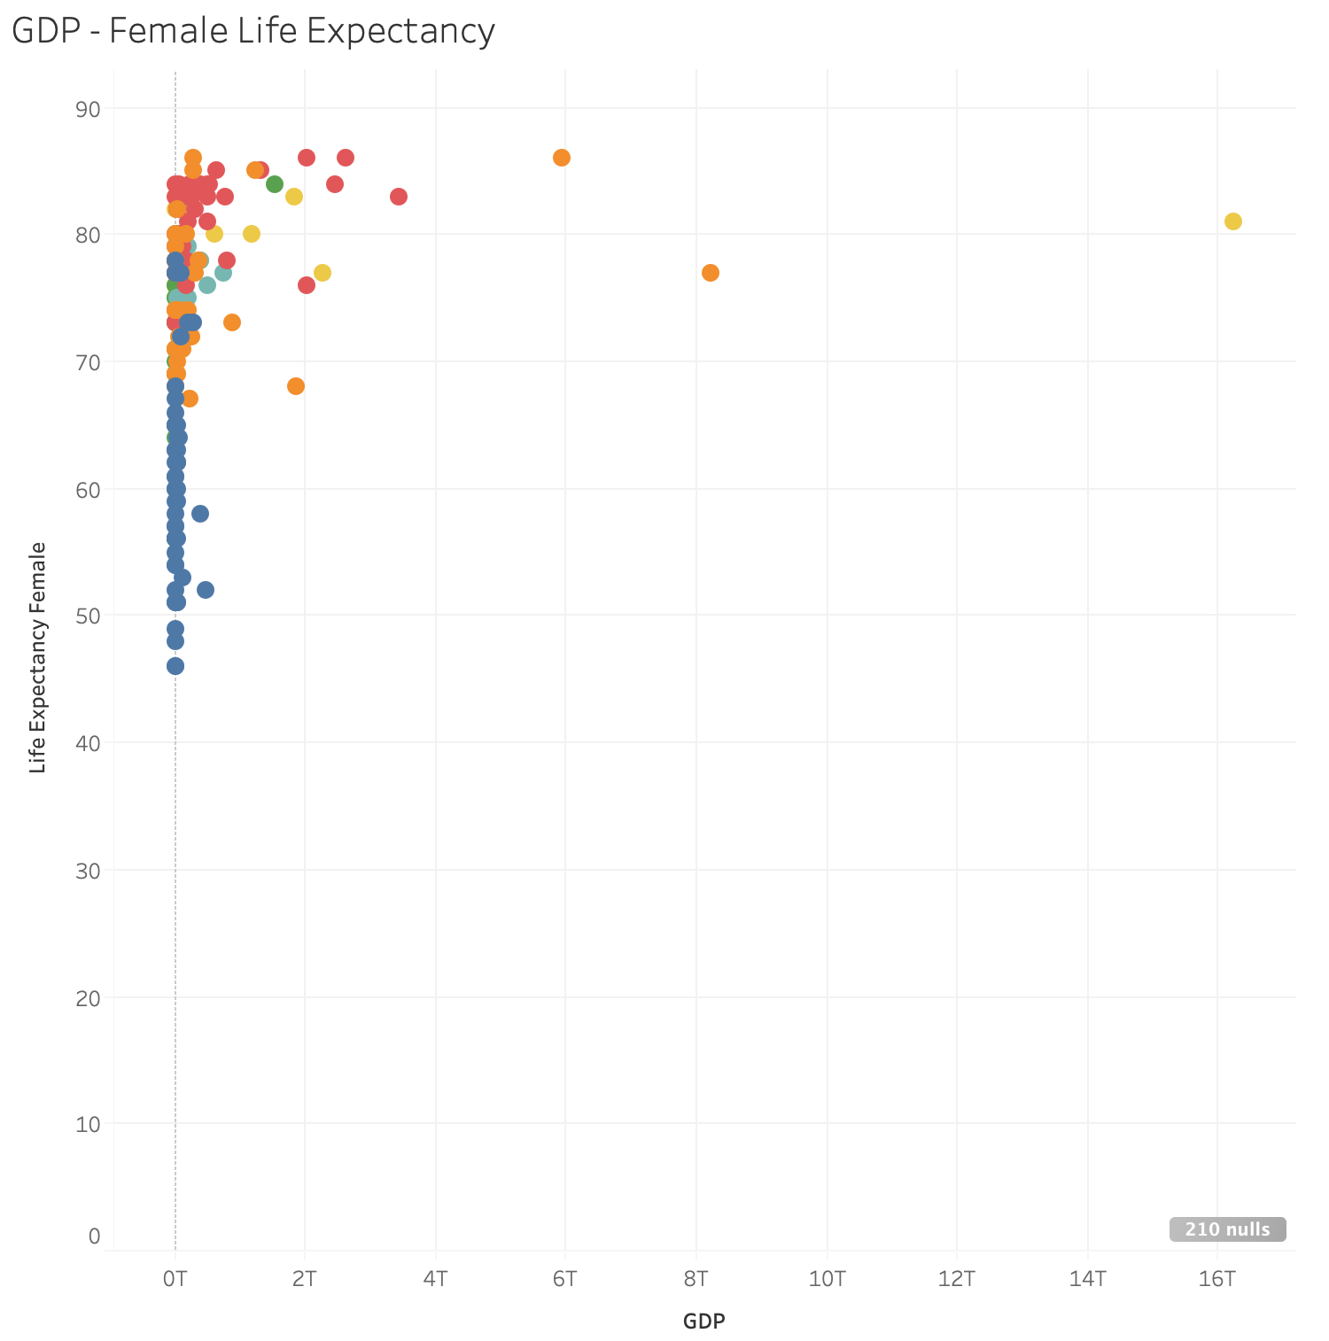
Maximum # of Data Dimensions on 2-D Graph
X-Position
Y-Position
Color

Slide 8
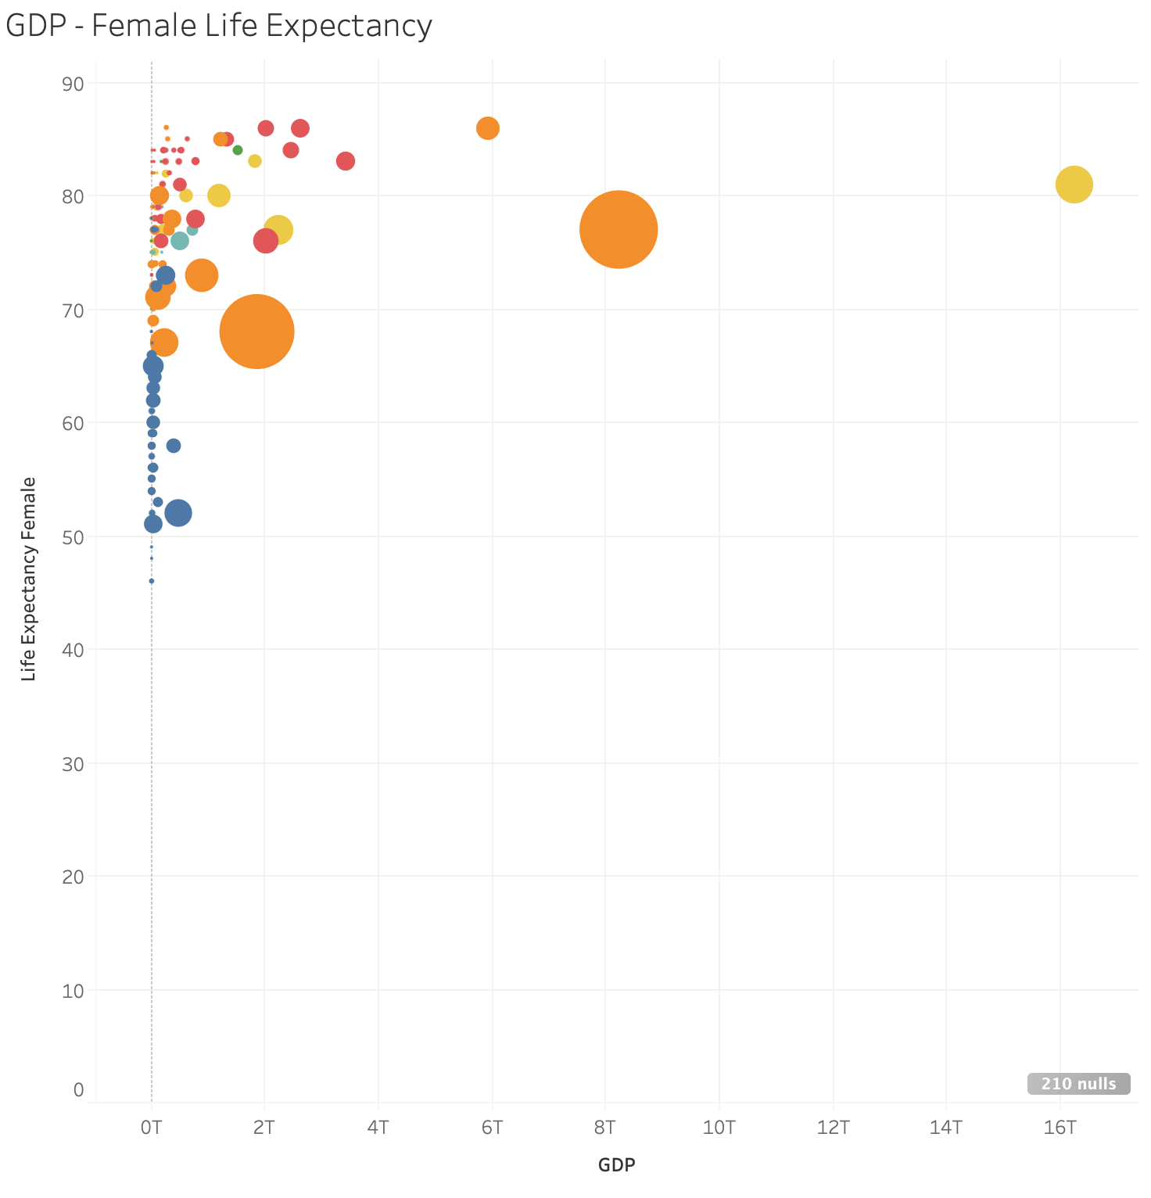
Maximum # of Data Dimensions on 2-D Graph
X-Position
Y-Position
Color
Size

Slide 9
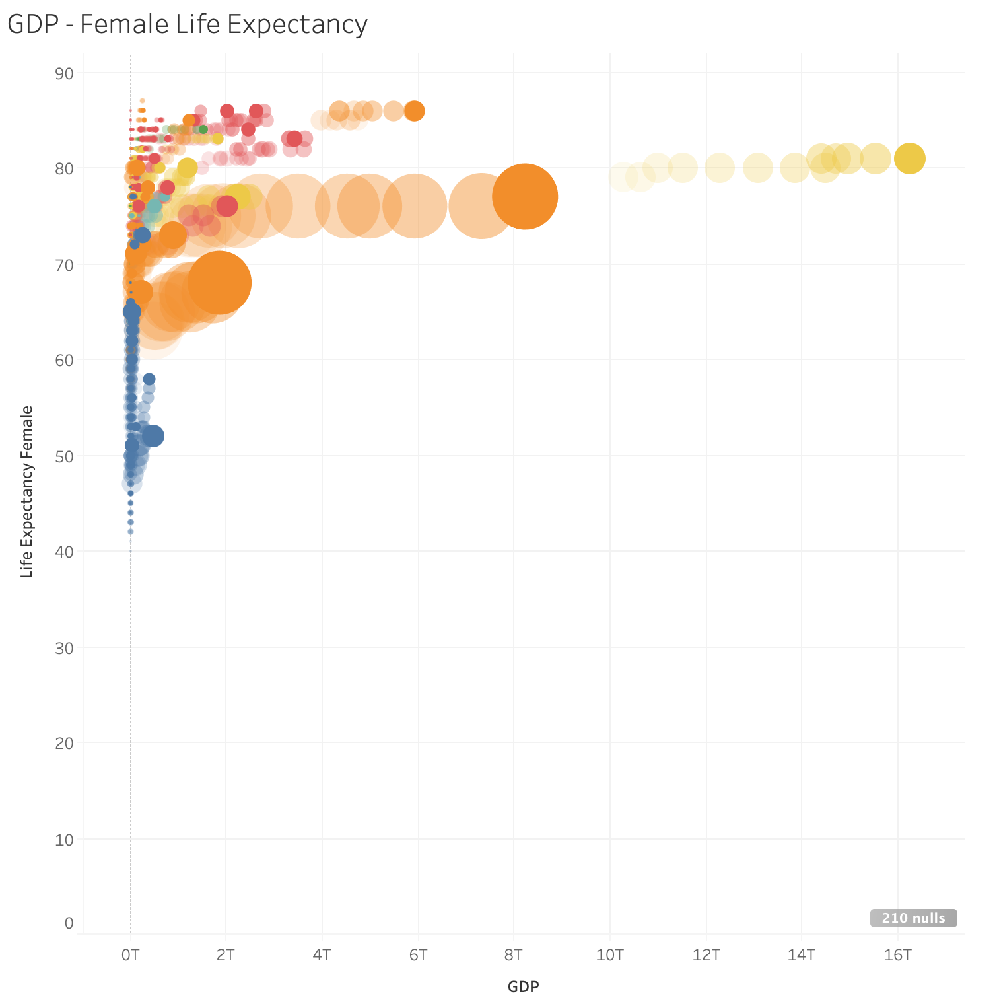
Maximum # of Data Dimensions on 2-D Graph
X-Position
Y-Position
Color
Size
Animation

Slide 10
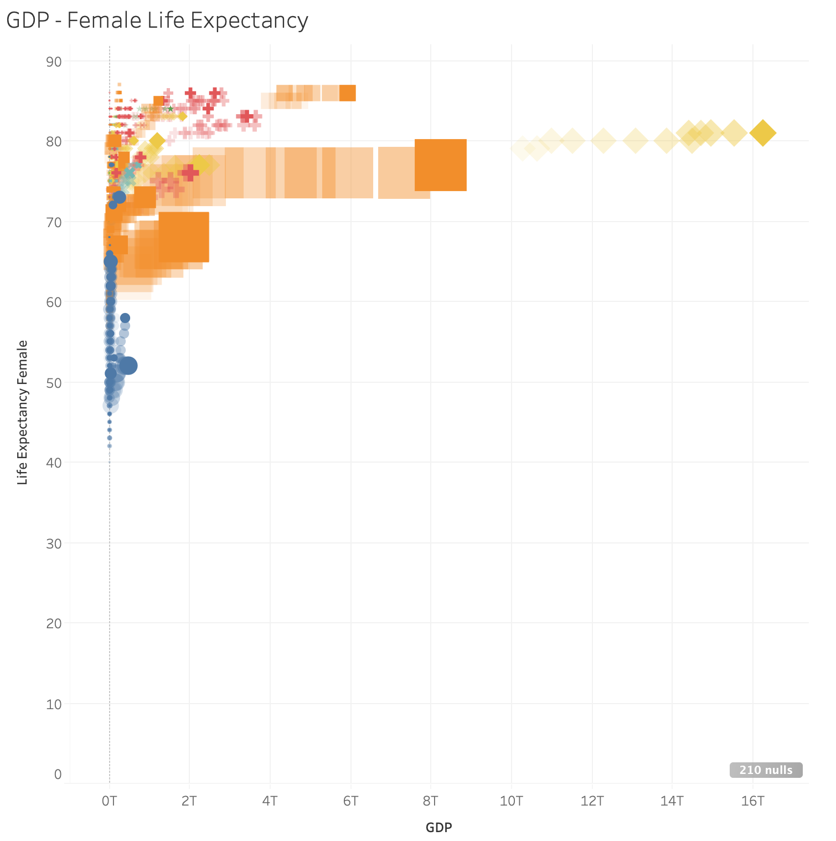
Maximum # of Data Dimensions on 2-D Graph
X-Position
Y-Position
Color
Size
Animation
Shape

Slide 11
Maximum # of Data Dimensions on 2-D Graph
X-Position
Y-Position
Color
Animation
Size
Shape
So, there are a maximum of 6 dimensions possible in a 2-D Graph – but we will only ever use a maximum of 5 (and usually fewer)
Only Use One

